Slide 1



Slide 2

Student’s activity monitoring in online learning environments
Supervised by:
Dr.Muhammad Faisal shehzad
Group Members:
Jahanzeb (FA17-BCS-050)
Saad bin aziz (FA17-BCS-068)
Department of Computer Science
COMSATS University Islamabad, Attock Campus

Slide 3
Outline
Introduction
Comparison table
Problem statement
Objectives
Development requirement
Methodology
Modern tools
Benefits
System background
Conclusion
Future work
Result
References
_______________________________

Slide 4

Introduction
Online or virtual learning is the learning method that is administrated through internet.
Our application will be used in a very positive manner in the context of the helping the teacher to let him/her know that how much his recorded lecture is being watched.
In our app, we have two main users Students and Teachers. Teachers will be able to see the percentage of the watched video and students will be able to log in in order to get monetarized by our application.
The main aim of this project is to provide a platform for the teachers where they will know that their students are watching the videos lectures which they were recording with lots of hard work. It will also help them to know the feedback of the students that how was the lecture
_______________________________

Slide 5
Applications And Comparison Table
Application Name | Features | Weakness
Real-Time Smart Attendance System using Face Recognition Techniques | automated attendance management system for students of a class by making use of face recognition technique | These all apps are just maintain and manage the attendance of student by only face detection and making use of face recognition technique.
Online attendance management system. | Innovative tool to maintain and manage the attendance of students/employees.
Online Student Management System in PHP | The user can view announcements, recent posts, and departments. From the instructor account, the user can view the student’s list and take actions on their grades by adding on each.
Smart attendance management system using face recognition | Used to detect faces in images and deep learning method is used to compute and compare feature facial of student to recognize them
_______________________________

Slide 6
Problem statement
In online learning environment the main problem arises it the students don’t watch the video lectures and just give their exams through cheating and this just wastes the hard work of the teacher who had made recorded lectures for them in the whole course .
The thing is when the student is being bound on watching the lectures the lecture then he will definitely learn from that lecture
Student will not do the cheating in the exam and teachers will not go blindly that students had watched the lecture and when he had learned the things taught to him then there will be no need to him to use unwanted means to solve his exam.
_______________________________

Slide 7
Objectives
Helping teacher to make his students to learn.
Making Students not to cheat in exams.
Students can watch lecture as many times as they want.
Making student teacher interaction
Sending and checking feedback on lecture easily
_______________________________

Slide 8
Development Requirements
Software Requirements dependence:
visual Studio code 3.5,
Programming language: Python, Django,
Database: MYSQL
Tools: viual Studio code
Visio 2016
Google Chrome
Hardware Requirements dependence:
laptop with a good camera
or external camera
4GB Ram

Slide 9
Methodology
We had used an algorithm in which when a student log in to their account lectures have been uploaded .
He will watch the lecture and his attendance will be counted automatically through webcam.
when our code will run first it will capture the frames and it will capture 6 frames per second .
If we will increase the size of the frames our execution time increases and size of the video which will be made of the user or the student will be very large , which may cause memory issue.
Teacher uploads the lecture and students watch the lecture and during lecture their attendance is counted automatically
_______________________________

Slide 10
Modern tools
Tools | Version | Rationale
Visual studio code | 3.3.2 | IDE
MySQL | 2018 | DBMS
Visio | 2016 | Diagram
MS Word | 2016 | Documentation
MS Power Point | 2019 | Presentation
_______________________________

Slide 11
Benefits
Student Activity monitoring of online lectures.
Summarize the student’s history of watched lecture.
Student can gives the feedback to the teacher.
Teacher can modify his lecture according to the feedback
Attendance will be marked automatically by our app based on monetarizing of student .
Teacher can add video lecture easily .
_______________________________

Slide 12
System Background
The main purpose behind designing this application is to provide a platform to the teacher in order to upload lectures and can check automatically generated attendance by application and students can watch the lecture and give feedback to the teacher and attendance will be marked automatically by checking consistency of student through eyeball and face detection.

Slide 13
conclusion
Our app will help the teacher in a sense that his all lectures will be watched by every student and attendance will be marked according to consistency of students during watching lecture through eyeball and face detection and it will help student in his exams because he will learn everything because of watching whole lecture with full concentration

Slide 14
Future work
Improvement security measures in app
Recognize the student from his picture.
Improvement of time complexity of algorithm.

Slide 15
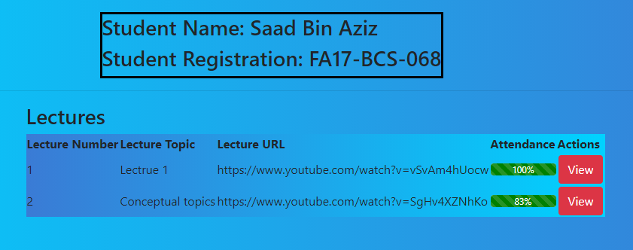
Result

Slide 16
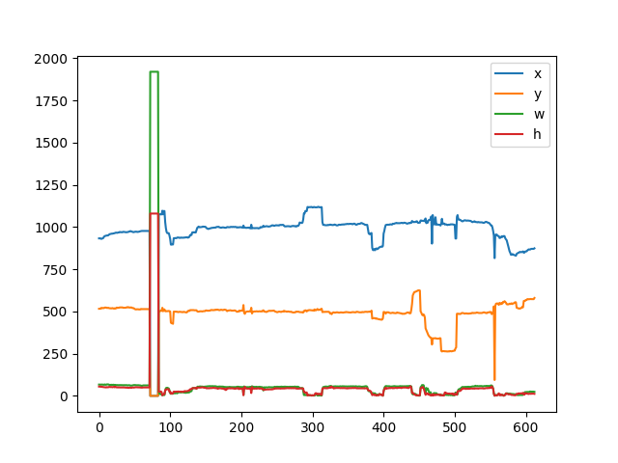
Result

Slide 17
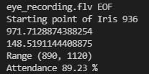
Result

Slide 18
References
1 https://docs.djangoproject.com/en/3.2/
2 https://docs.djangoproject.com/en/3.2/ref/templates/builtins/
3 https://docs.djangoproject.com/en/3.2/topics/db/models/
4 https://www.w3schools.com/bootstrap/bootstrap_modal.asp
5 https://getbootstrap.com/docs/4.0/components/progress/
_______________________________

